Slide 1
SUPPORT system in Aust-Agder
7.05.2015. Preili
Agnese Bjerkholt

Slide 2
SUPPORT system in Aust-Agder
Lime inn bildet

Slide 3
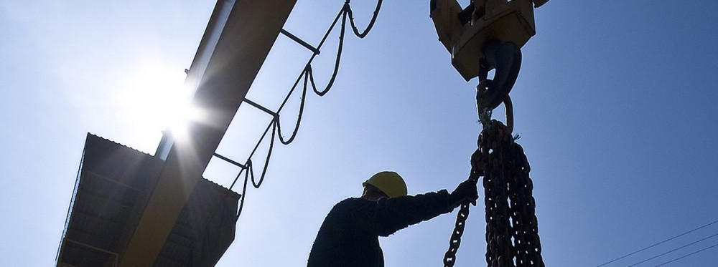
National support system
SIVA
Innovation Norway
Norwegian Research Council
Norwegian Patent Office

Slide 4
SIVA
www.siva.no
Public enterprise owned by the Norwegian Ministry of Trade and Fisheries
50 employees is located in Trondheim
Facilitator, partner and investor in larger industrial projects
Co-owner of over 100 innovation companies
Incubation
Business gardens
Norwegian Innovation Clusters

Slide 5

Innovation Norway
http://www.innovasjonnorge.no
Innovation Norway is the Norwegian Government's most important instrument for innovation and development of Norwegian enterprises and industry
Proffilering – rådgivning – nettverk – kompetanse - finansiering
Official trade representative abroad represented in more than 30 countries
Innovation Norway - Balticum
Elizabets 51, Riga
riga@innovationnorway.com

Slide 6
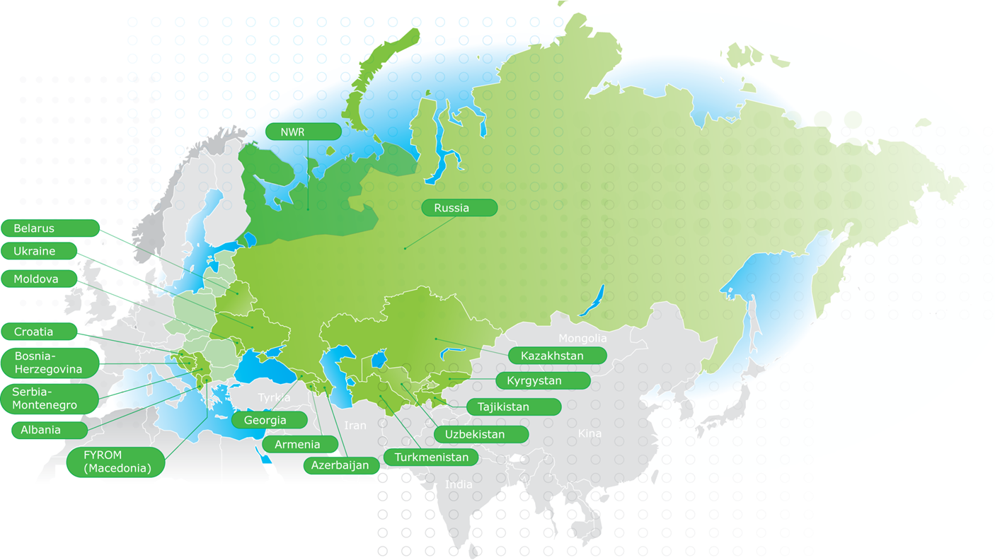
Notes:
Investeringsfondene for Russland og Østeuropa
Norske små og mellomstore bedrifter med ambisjoner om etablering i virkeområdet, som har et godt prosjekt med gjennomførte markedsundersøkelser, forretningsplan, kontakter og eventuelle samarbeidspartnere.

Slide 7
Innovation Norway
Enhancing innovation in Norwegian enterprises and industry
Building competitive Norwegian enterprises at both domestic and international markets
Promoting Norwegian enterprises
Promoting Norway as an attractive tourist destination
Securing development in rural areas
Transforming ideas into successful business cases
Promote interaction between enterprises, knowledge communities and R&D institutions
Notes:
Bedriftsfinansiering – lån, tilskudd, garantier
Etablerertilskudd fase 1 og fase 2
Forsknings og utviklingskontrakter IFU/OFU – samarbeid mellom leverandør og kundebedrift/offentlige
Miljøteknologiordningen
Landbruk, marine næringer, SkatteFUNN, såkornfond

Slide 8
Norwegian Reserch Council
http://www.forskningsradet.no
National strategic and funding agency for research activities, and a chief source of advice on and input into research policy for the Norwegian Government.
Advisers at the Research Council have thorough knowledge of trade and industry and understand how companies can benefit from research.
Provides support to private and public institutions seeking to develop new knowledge and new products, procedures and services.
Notes:
Tips for writing grant proposals, assistance in establishing contact with research communities, an overview of research activities in your company’s areas, whether your activities require research and development Information about funding opportunities Information about patenting and intellectual property right

Slide 9
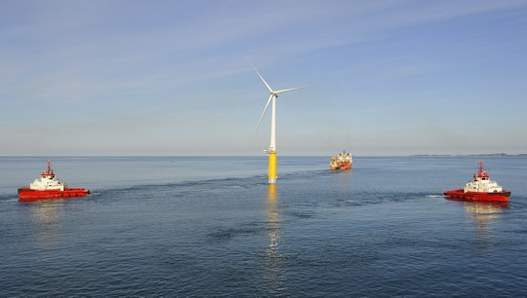
Floating wind power soon a reality
The world's first full-scale floating wind turbine is now operational. Located off Norway's southwest coast, the wind turbine was launched earlier this autumn, marking a milestone in the development of large, offshore floating wind farms.
http://www.forskningsradet.no/servlet/Satellite?c=Nyhet&pagename=renergi%2FHovedsidemal&cid=1253952259218&p
Notes:
International collaboration
The Hywind project is the very essence of successful international collaboration: Siemens Wind Power of Denmark produced the wind turbine and its tower, France’s Technip built the floating structure and installed the windmill, and Nexans Norway produced and laid Hywind's power cable to land.

Slide 10

Norwegian Patent Office
http://www.patentstyret.no/
You can protect your creation, logo or invention with trademarks, designs and patents.

Slide 11
Regional support system
Aust-Agder County Municipality, Business Department
County Governor of Aust-Agder, Agriculture and Food
Innovation Norway, Agder
Regional Business Fonds
University of Agder, Centre for Entrepreneurship
Young Entrepreneurs of Agder
Coventure AS
Connect Sørlandet
NAV Aust-Agder

Slide 12
Aust-Agder County Municipality
http://www.austagderfk.no/
The level of public government between the national government (Stortinget) and the municipalities. While the term county (fylke) denotes the geographical area, the county council (fylkeskommune) is the democratically elected body, with responsibilities for public welfare in the county. Norway's public sector is comprised of three levels: the national government, the municipalities, and between them, the county councils.

Slide 13
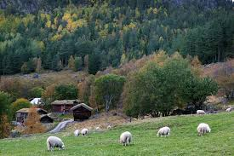
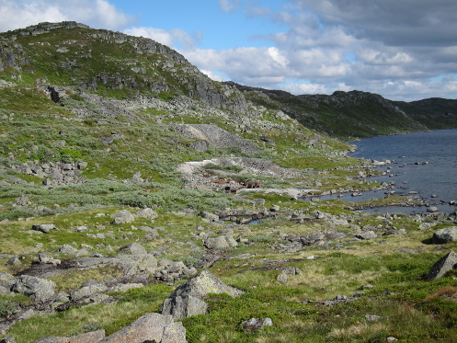
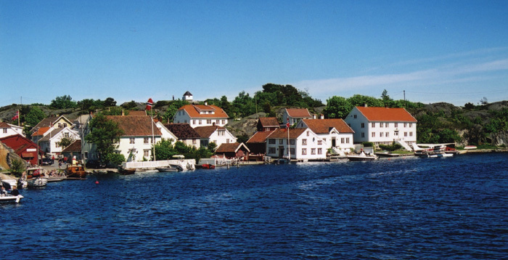
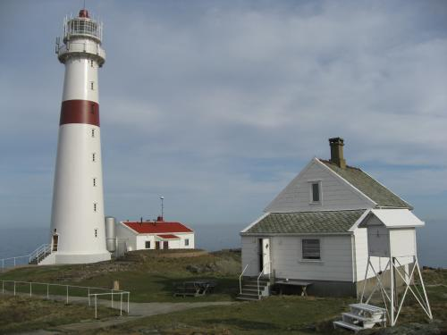

Slide 14

Regional Planning
Regional Development Plan
Agder 2020
VINN Agder 2030
LIM Agder 2015-2019
Regional Transportplan
International Strategi
Agder, http://intportal.vaf.no/
Notes:
Likestillingsarbeidet på Agder fokuserer på kjønn, etnisitet, funksjonsevne, alder, religion/livssyn, seksuell orientering/kjønnsuttrykk/ kjønnsidentitet og sosial bakgrunn.

Slide 15

Regional Development Plan Agder 2020
http://www.regionplanagder.no/
The plan aims at improving five main areas in the region:
Climate: high ambitions – low emissions
The Good Life: for everyone
Education: value creation based on everyone
Communications: the sustainable choices
Culture and the arts: experience for life

Slide 16
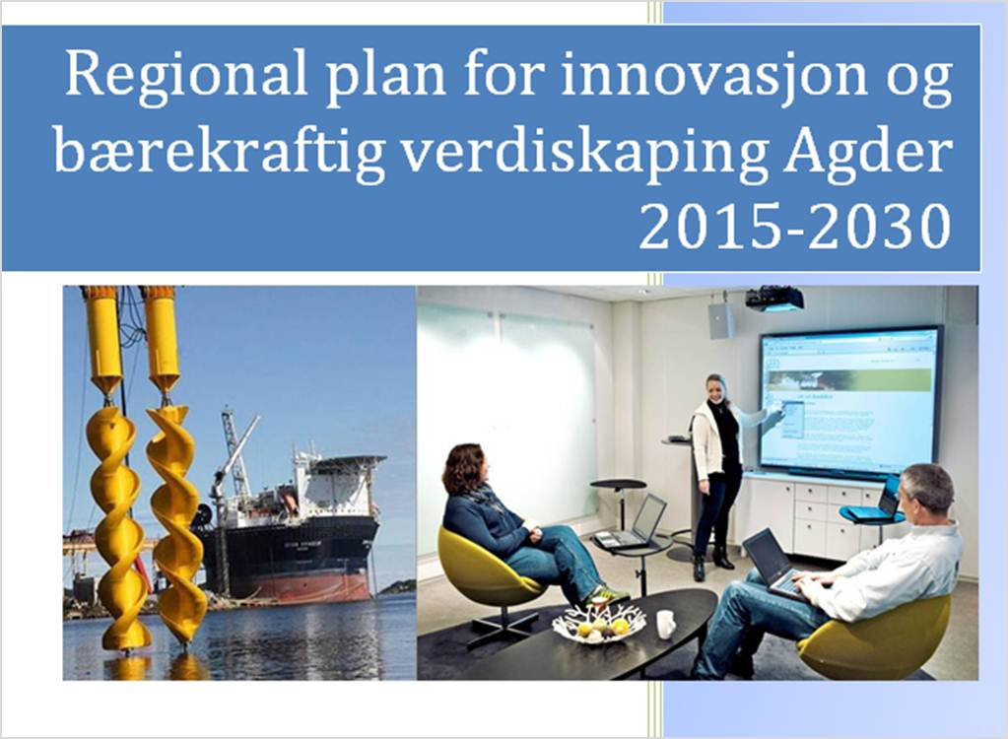
VINN Agder 2030
Regional Plan for Innovation and Development that provides economic, social and environmental benefits in the long term having regard to the needs of living and future generations:
Entrepreneurship
FoUoI
Tourism – Best for Children
Agriculture and
marine industries
Innovation in public sector

Slide 17
Aust-Agder County Municipality
Business Department
Provides assistance to industries or enterprises in need of information concerning site locations, labour force, investment and credit possibilities.
Promote Entrepreneurship
Regional Development Projects
Coordinative consultative functions with local municipalities and R&D institutions
Rural Tourism
Regional Research Fund
International Projects

Slide 18

Promoting Entrepreneurship
Smart-Start Introduction course
Business Economics and Bookkeeping
Legislation for Startups
Web and Social Media as a Marketing Channel
Business
Planning
SEKT

Slide 19
Regional Development Projects

Slide 22

Regional Research fund Agder
http://www.regionaleforskningsfond.no/prognett-agder/Forside/1253953779726
Strengthen research intended to increase and improve regional innovation and regional development
Increase R&D efforts in all Norwegian regions
Improve research quality and competitiveness of the R&D institutions in all regions
Organise arenas for the sharing of knowledge and experiences
Establish cooperation with national and international programmes and activities.

Slide 23
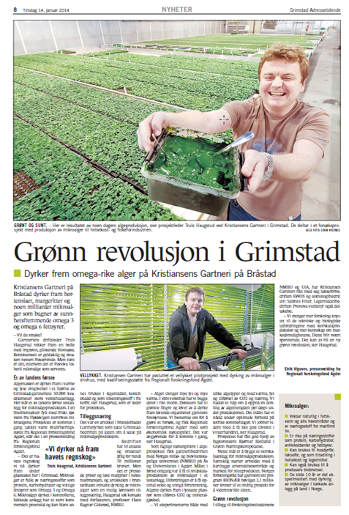

Slide 24

Regional Business Fonds
Arendal, Grimstad og Froland
Lillesand, Birkenes og Iveland
Tvedestrand, Risør, Gjerstad, Vegårshei
og Åmli
Bykle, Valle, Bygland
Evje og Hornnes
Max. 50%; 200 000 NOK

Slide 25
County Governor of Aust-Agder
Agriculture and Food
http://www.fylkesmannen.no
Acting in collaboration with other regional and local entities, the County Governor has a responsibility to facilitate business development and innovation:
cooperation on county-wide planning,
business development planning,
farm holiday schemes,
tourism initiatives,
the development of food production,
forestry initiatives and bioenergy programmes.
Notes:
The County Governor also administers the rural development (BU) grants for measures intended to assist with research and facilitate business development. The grants are intended to promote the development of profitable farming-related businesses in rural areas. The County Governor also has a leading role in promoting Innovation Norway's local food programme (which provides financial support for competence-building, brand-awareness-raising and networking activities).

Slide 26
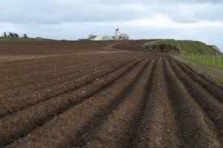
The County Governor is responsible for drawing up and implementing a regional business development strategy for agriculture.
The County Governor also administers the rural development grants for measures intended to assist with research and facilitate business development. The grants are intended to promote the development of profitable farming-related businesses in rural areas.

Slide 27
Innovation Norway, Agder
Providing financial support, advisering and courses to entrepreneurs in Agder.
Go Lean
Business Model Canvas
Etablerertilskudd, SklatteFUNN, EU Financing, Crowfounding
How to Pitch to investors
International marked
Grundertelefon
Notes:
Hva skal du levere?
Hvem er kunden?
Hvem er venner og konkurrenter?
Hvordan skal du selge?
Hvordan skal du ta betalt?
Hvordan skal du levere?

Slide 28
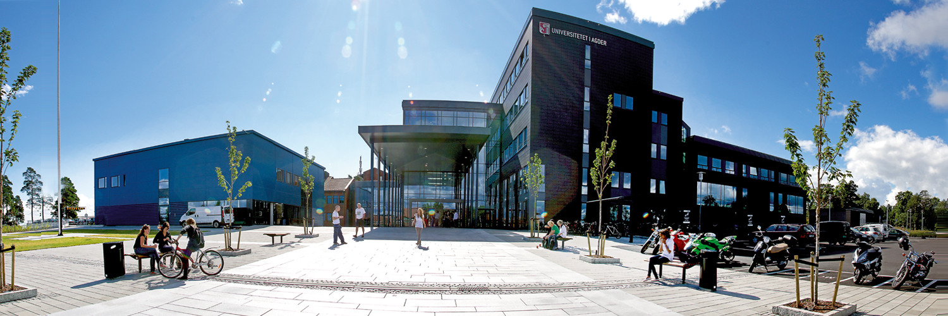
University of Agder
Centre for Entrepreneurship
http://www.uia.no/senter-og-nettverk/senter-for-entreprenoerskap
Stimulating entrepreneurship and creating an entrepreneurial mindset among those educated at the University of Agder.
Notes:
Senter for entreprenørskap, SfE, ble etablert i 2005 i samarbeid med Agderforskning. Bakgrunnen for etableringen var å forberede studenter til arbeidslivet og innovasjon på arbeidsplassen ved å styrke dialogen mellom akademia og næringslivet.
Senteret har årlig over 300 studenter fordelt på over ni programmer, og tilbyr emner på alle nivåer, fra bachelor- til master og doktorgradsnivå. Senteret samarbeider med regionale, nasjonale og internasjonale aktører, blant dem Innovasjon Norge. Dette har resultert i to «flaggskip» programmer – Gründer Lab og Internationalization Lab. Det siste er et samarbeid som gir mastergradsstudenter muligheten til å jobbe med eksisterende virksomheter som ønsker å internasjonalisere virksomheten sin.

Slide 29

Young Entrepreneurship og Agder
A national organization with network of strong self-supporting regional offices.
Establishing continuity in entrepreneurial education throughout the educational system, with a natural progression from pre-school education to business.

Slide 30
Develop children’s and youth’s creativity,
creation, and believe in themselves.
Provide children’s and youth’s understanding of the importance of value creation and innovation in business
Promote children’s and youth’s team work capability and responsibility
Provide understanding and knowledge of ethics and rules of business
Strengthen cooperation between local businesses and schools
Inspire future value creation in a social, cultural and economical context
Member of Junior Achievement – Young Enterprise (JA-YE Europe)

Slide 31

Coventure AS
http://coventure.no
Business incubation: an instrument for creating new business.
Part of the national incubation program supported by
the Norwegian Ministry of Trade:
Business competence
Network (public & private)
Risk capital (pre-seed fund)
Cooperates with incubators in Sweden and Denmark (Interreg)

Slide 32

Connect Sørlandet
http://www.connectnorge.org/index.php/nb/om-oss/regioner/connect-sorlandet
Norway’s largest innovation Network;
Not - for – profit, No charge
A meetingplace between
Entrepreneurs,
Business Competence,
Partners and Capital
Connect Latvija - Elmārs Baltiņš, Manager
http://www.connectlatvia.lv

Slide 33

NAV Aust-Agder,
The Norwegian Labour and Welfare Administration
https://www.nav.no/no/Lokalt/Aust-Agder
Apply for unimployment benefits in case of planning and starting opp new business:
Planning new business: opp to 6 mnd.
Starting new business: opp to 3 mnd.
https://www.nav.no/en/Home/Work+and+stay+in+Norway/Relatert+informasjon/Selected+professions+and+industries.358827.cms

Slide 34

Lokal support system
Sørlandsporten Businessgarden
Etablerersenteret IKS
Lokal municipalities

Slide 35


Sørlandsporten Businessgarden
http://sorlandsporten-naringshage.no/
Located at Risør Municipality
24 companies
Excellent office and business
premises…
Notes:
Næringshagene er lokal næringsutvikling der talenter, idéer og prosjekter møter profesjonell bistand til å orientere seg i virkemiddelapparatet, utvikle forretningsidéer, arbeide med markedet og finne kapital. Næringshagene tilbyr også attraktive forretningslokaler som er tilrettelagt for samspill mellom bedrifter.

Slide 36

Etablerersenteret IKS
http://www.grunderweb.no/
Owners: Arendal and Froland Municipalities
Partners: Grimstad and Tvedestrand Municipalities
75 885 inhabitants (112 105 in Aust-Agder County)
Consulting, education, support, nettwork, office facilities to Business- and educationcluster Sørlandet Kunnskapshavn
Notes:
Veiledning

Slide 37
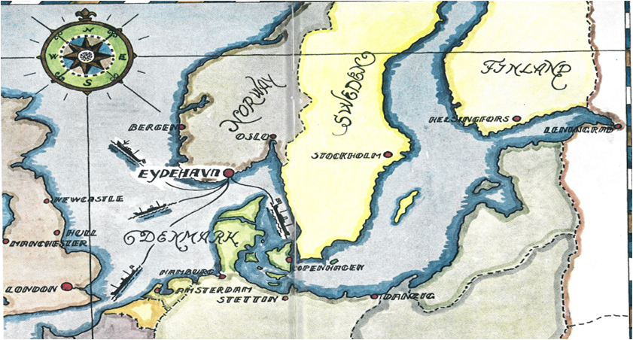

Slide 38

Arendal Municipality
Arendal is the administrative center of Aust-Agder county, and belongs to the geographical region of Sørlandet.
43 500 inhabitants
Signifficant industries:
Offshore Loading and Offloading, Mooring and Anchoring (Aker Solutions, APL),
World leading oil & gas tech Cluster (NODE)
Complete platform solutions (Sevan Marine)
Rescueboat (Norsafe AS)
TEDx – Ideas Worth Spreading

Slide 39
Sørlandet Kunnskapshavn
Sørlandet Science center
Etablerersenteret IKS
Business- and educationcluster Sørlandet Kunnskapshavn
Voksenopplæring

Slide 40
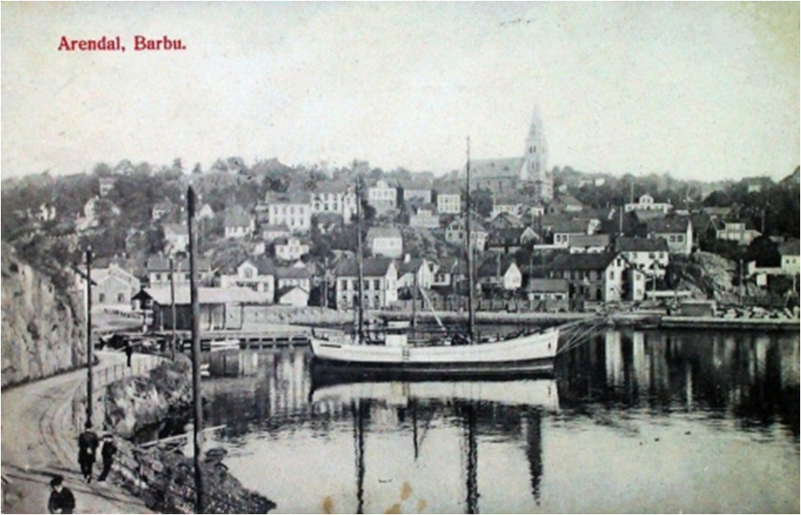
Arendal Municipality
Establishment and development of business areas competitive for the exixting businesses and atracting the new enterprises to the region.
Strenghten the position of Arendal as place for entrepreneurship and business based om competence.
Follow the Regional Plan Agder 2020
Cooperation with the other municipalities in Eastern Agder, common businessplan;
Development of Sørlandet Kunnskapshavn and Science Senter Sørlandet
Promote Entrepreneurship
Notes:
Felles web-portal, kommunene fremstå samlet
Felles næringsarealbank
Felles gründersatsing
Fokus på kompetanseheving og møteplasser
Bygge nettverk på tvers av bransjer og ansvar

Slide 41
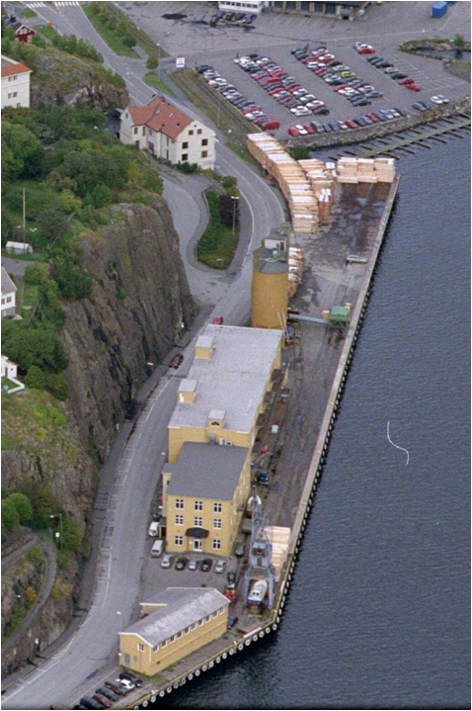

Slide 42
